Slide 1

Oracle 11g: SQL
Chapter 9
Joining Data from Multiple Tables

Slide 2
Objectives
Identify a Cartesian join
Create an equality join using WHERE clause
Create an equality join using JOIN keyword
Create a non-equality join using WHERE clause
Create a non-equality join using JOIN…ON
Create a self-join using the WHERE clause
Create a self-join using the JOIN keyword
Distinguish an inner join from an outer join
Create an outer join using the WHERE clause
Create an outer join using the OUTER keyword
Use set operators to combine the results of queries
Oracle 11g: SQL

Slide 3
Purpose of Joins
Joins are used to link tables and connect related data in a relational database
Joins can be created through:
  Conditions in a WHERE clause
  Use of JOIN keywords in FROM clause
Oracle 11g: SQL
Notes:
WHERE – old
JOIN – new

Slide 4
Cartesian Joins
Created by omitting joining condition in the WHERE clause or through CROSS JOIN keywords in the FROM clause
Results in every possible row combination (m * n)
Oracle 11g: SQL

Slide 5
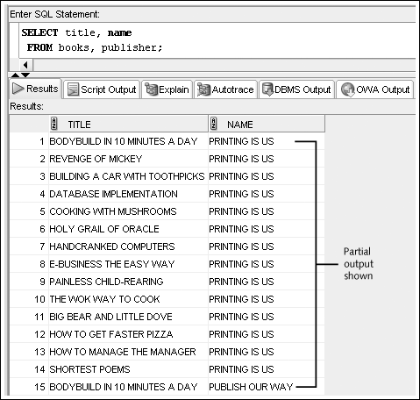
Cartesian Join: Omitted Condition

Slide 6
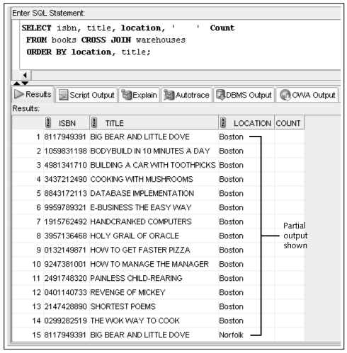
Cartesian Join: CROSS JOIN Keywords

Slide 7
Equality Joins
Link rows through equivalent data that exists in both tables
Created by:
  Creating equivalency condition in WHERE clause
  Using NATURAL JOIN, JOIN…USING, or JOIN…ON keywords in the FROM clause
Oracle 11g: SQL

Slide 8
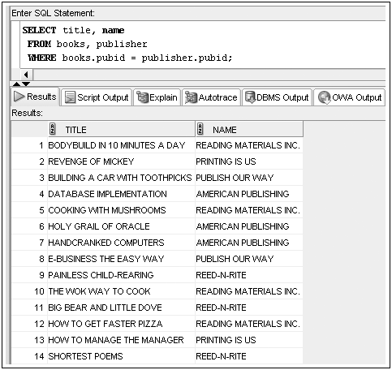
Equality Joins: WHERE Clause Example
Oracle 11g: SQL

Slide 9
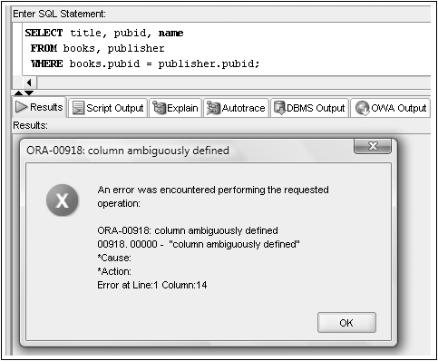
Qualifying Column Names
Columns that are in both tables must always be qualified
Oracle 11g: SQL

Slide 10
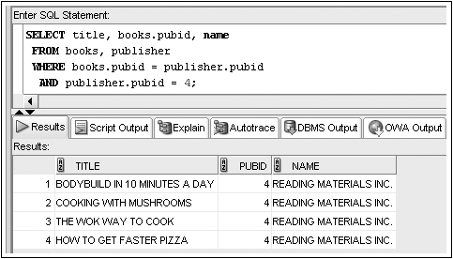
WHERE Clause Supports BOTH Join and Row Selection Conditions
Oracle 11g: SQL

Slide 11
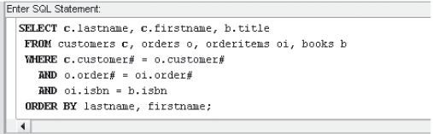
Joining More Than Two Tables
Oracle 11g: SQL
Notes:
Joining N tables requires N-1 join conditions

Slide 12

Equality Joins: NATURAL JOIN
Oracle 11g: SQL
Notes:
Automatically uses same name columns for join (i.e. pubid)
Do not need to qualify columns in both tables

Slide 13

Equality Joins: JOIN…USING
Oracle 11g: SQL
Notes:
Column pubid is common, so does not need to be qualified

Slide 14

Equality Joins: JOIN…ON
Oracle 11g: SQL
Notes:
Required if common columns have different names

Slide 15
JOIN Keyword Overview
Use JOIN…USING when tables have one or more columns in common (with same name)
Use JOIN…ON when same named columns are not involved or a condition is needed to specify a relationship other than equivalency (next section)
Using the JOIN keyword frees the WHERE clause for exclusive use in restricting rows
Oracle 11g: SQL

Slide 16
Non-Equality Joins
In WHERE clause, use any comparison operator other than the = equal sign
In FROM clause, use JOIN…ON keywords with a non-equivalent condition
Oracle 11g: SQL

Slide 17

Non-Equality Joins: WHERE Clause Example
Oracle 11g: SQL

Slide 18

Non-Equality Joins: JOIN…ON Example
Oracle 11g: SQL

Slide 19
Self-Joins
Used to link a table to itself
Oracle 11g: SQL
Notes:
For unary relationships or recursive foreign keys
Requires the use of table aliases
Requires the use of a column qualifier

Slide 20
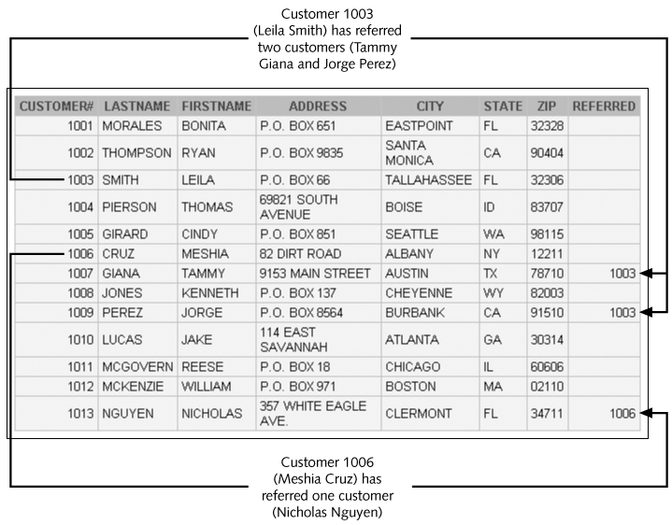

Slide 21
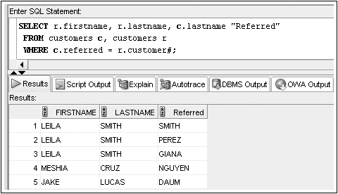
Self-Joins: WHERE Clause Example
Oracle 11g: SQL

Slide 22
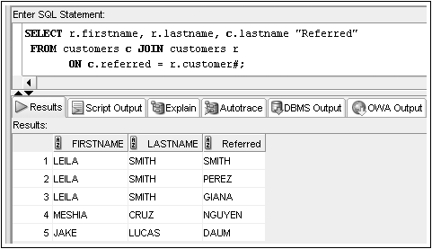
Self-Joins: JOIN…ON Example
Oracle 11g: SQL

Slide 23
Outer Joins
Use outer joins to include rows that do not have a match in the other table
In WHERE clause, include outer join operator (+) immediately after the column name of the table with missing rows to add NULL rows
In FROM clause, use FULL, LEFT, or RIGHT with OUTER JOIN keywords
If multiple join conditions are used, the outer join condition may be required in all of the join conditions to retain nonmatching rows
Oracle 11g: SQL

Slide 24
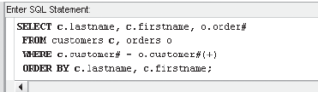
Outer Joins: WHERE Clause Example
Oracle 11g: SQL

Slide 25
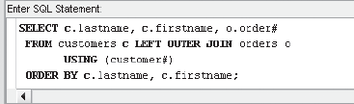
Outer Joins: OUTER JOIN Keyword Example
Oracle 11g: SQL

Slide 26
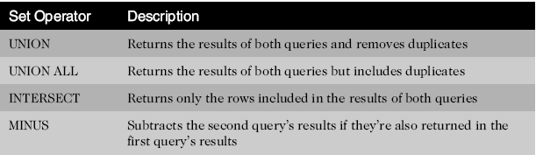
Set Operators
Used to combine the results of two or more SELECT statements
Oracle 11g: SQL

Slide 27
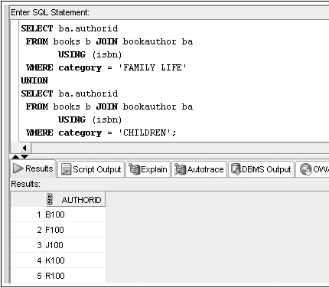
Set Operators: UNION Example
Notes:
Authors who have written FAMILY LIFE or CHILDREN

Slide 28
Set Operators: INTERSECT Example
What is result if last example was INTERSECT instead of UNION?
Oracle 11g: SQL
Notes:
Only authors who have written books for both FAMILY LIFE and CHILDREN

Slide 29
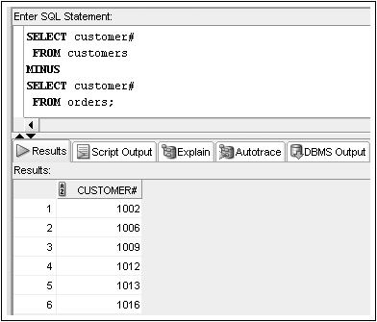
Set Operators: MINUS Example
Oracle 11g: SQL
Notes:
Give me customer# who have not placed an order
Should do DISTINCT on second query

